Slide 1
Abrupt Climate Change
October 24, 2012
G 610 – Climate of the Holocene
Presenter: Erin Dunbar
Assistant: Jesse Senzer

Slide 2
Abrupt Climate Change
Alley, R.B. et al
Defines abrupt climate change
Recent abrupt changes before the instrumentation timeframe
Threshold models
Urges more effort on the study of abrupt change

Slide 3
What is abrupt climate change?
“...occurs when the climate system is forced to cross some threshold, triggering transition to a new state at a rate determined by the climate system itself and faster than the cause.”
-Committee on Abrupt Climate Change, National Research Council
Notes:
Says nothing about the speed or size of the forcing, doesn’t indicate speed of the transition (determined by the climate system)
… many scientists measure time on geological scales, most people are concerned with changes and their potential impacts on societal and ecological time scales. From this point of view, an abrupt change is one that takes place so rapidly and unexpectedly that human or natural systems have difficulty adapting to it. Abrupt changes in climate are most likely to be significant, from a human perspective, if they persist over years or longer, are larger than typical climate variability, and affect sub-continental or larger regions. - National Research Council
Does a particular forcing cause abrupt climate change? Maybe, maybe not. Important to know what changes have occurred in the past and apply to current models
Ball/cup model for thresholds, forces leading to threshold may not tip
Are humans driving the climate toward an abrupt change? What does history tell us?

Slide 4
Notes:
Limitations on record keeping by instrumentation
~300 yrs temp, precip, baro
Longer records through other methods (coring, etc.)
Observable climate change
ENSO 1976
Younger Dryas
Little Ice Age & 8200 year event
Moon Lake, ND Dust bowl

Slide 5
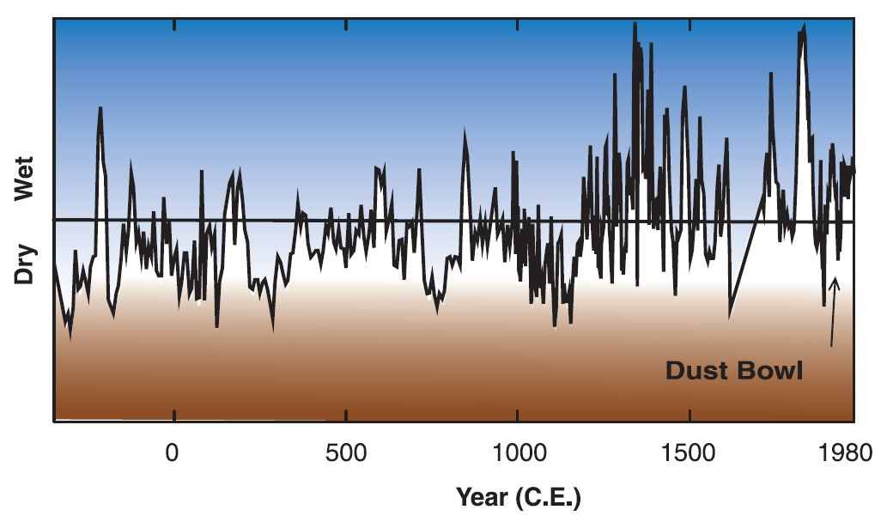
Moon Lake, North Dakota
Alley, R.B. et al, Science 2003 Vol. 299, Figure 2
Notes:
Salinity measurements – Latitude ~47⁰
Diatom assemblages preserved in sediment cores from closed basin lakes can provide high resolution records of past hydrologic and climatic conditions, including long term patterns in the intensity, duration, and frequency of droughts …… A sub decadal Record of inferred salinity for the past 2300 years indicates that extreme droughts of greater intensity than those during the 1930s ‘Dust Bowl’ were more frequent prior to A.D. 1200. This high frequency of extreme droughts persisted for centuries and was most pronounced from A.D. 200–370, A.D. 700–850 and A.D. 1000–1200. A pronounced shift to generally wetter conditions with less severe droughts of shorter duration occurred at A.D. 1200. This abrupt change coincided with the end of the ‘Medieval Warm Period’ (A.D. 1000–1200) and the onset of the ‘Little Ice Age’ (A.D. 1300–1850). – Laird, 1998 (abstract)
… Different kinds of diatoms favor more or less saline conditions, so an analysis of the types of diatoms found in the layers of lake sediment can be used to reconstruct variations in salinity. The changes in salinity are a reflection of drought variability in this region over the last 2000 years. The sediments were sampled at an average interval of 5.3 years, and radiocarbon and lead- 210 dates provided age control. The gap in the record from the early 17th to the early 18th century is due to loss of data from the core drying out.
One of the notable features about this paleodrought proxy is the abrupt shift in the data about A.D. 1200. This record raises the possibility that different, relatively stable drought "states" or "modes" may have existed over the past 2,000 years. The graph on the right shows a marked shift between high and low salinity conditions around A.D. 1200, suggesting a change in general drought characteristics about this time. Before A.D. 1200, this record indicates regular and persistent droughts….. In sharp contrast with the period prior to ca. A.D. 1200, the current mode of drought appears relatively wet and free of truly severe drought.
http://www.ncdc.noaa.gov/paleo/drought/drght_laird96.html

Slide 6
Passing a threshold
Trigger
New steady state
Amplifier
Globalizer
Persistence
Notes:
Models are based on threshold barriers
Trigger – Initial forcing (pushes over threshold)
Amplifier – Feedback loop (albedo, snow fall)
Globalizer – spreading of influence from smaller region to larger (General Circulation Models, etc)
Persistence – Feedback loop that allows for lasting conditions in altered state
Considerations when building a model
Scale of climate change in space and time
Regional modes (what is the dominant climate mode in that region?)
Where does data collected fit in the model? Trigger, amplifier, globalizer?
Consider the THC

Slide 7
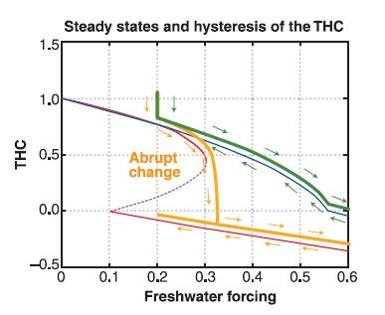
THC Steady States
Alley, R.B. et al, Science 2003 Vol. 299, Figure 4
Notes:
Stommel box model
Simplified model
fresh water loss at lower latitudes, equivalent to fresh water gain at higher latitudes
Red is weak mixing (normal oceanic or wind driven)
Blue is strong mixing
Function of freshwater forcing (net forcing?) f(fresh) = THC strength
Green is input of fresh water at high mixing
Orange is input at low mixing
Initial input is the same for both models
Cannot return to blue after red, new equilibrium
GCM using mixing represent oceanic mixing as strong, uniform mixing. Errors in the models may be due to the exclusion of thresholds

Slide 8
Is the Change Significant?
What is the impact of climate change?
  Ecological
  Economic
What is the impact of our reaction?
Where does the human contribution fit?
Will the changes be like the changes in the past?
Notes:
Going back to the initial statement
Think evolution, think scale, lifespans
Corals, forests
Ability to adapt to new state of climate
Slow changes, slow response
Abrupt changes, no chance for response
Water and drought – economic impact
What scale? Crops, etc.
Faster, less anticipated change is more costly
Cost of change
Cost of legislation to change emissions instead of something drastic
Changes for reform are laid out in years
Easy to say human impact is a trigger, but maybe we set the stage for abrupt change via natural changes
Will the abrupt changes initiate new climate nodes, or revisit climate nodes of the past?
Also as conditions near thresholds, the predictability of behavior is lost. What will the stability be?

Slide 9
The difficulty of identifying and quantifying all possible causes of abrupt climate change, and the lack of predictability near thresholds, imply that abrupt climate change will always be accompanied by more uncertainty than will gradual climate change.
Alley, R.B. et al, Science 2003 Vol. 299
Notes:
Makes it difficult to write policy to minimize the impact of abrupt change. How can we prepare?
More effort in this area needs to be done.
Rolling Stone
This number is the scariest of all – one that, for the first time, meshes the political and scientific dimensions of our dilemma. It was highlighted last summer by the Carbon Tracker Initiative, a team of London financial analysts and environmentalists who published a report in an effort to educate investors about the possible risks that climate change poses to their stock portfolios. The number describes the amount of carbon already contained in the proven coal and oil and gas reserves of the fossil-fuel companies, and the countries (think Venezuela or Kuwait) that act like fossil-fuel companies. In short, it's the fossil fuel we're currently planning to burn. And the key point is that this new number – 2,795 – is higher than 565. Five times higher.
The Carbon Tracker Initiative – led by James Leaton, an environmentalist who served as an adviser at the accounting giant PricewaterhouseCoopers – combed through proprietary databases to figure out how much oil, gas and coal the world's major energy companies hold in reserve. The numbers aren't perfect – they don't fully reflect the recent surge in unconventional energy sources like shale gas, and they don't accurately reflect coal reserves, which are subject to less stringent reporting requirements than oil and gas. But for the biggest companies, the figures are quite exact: If you burned everything in the inventories of Russia's Lukoil and America's ExxonMobil, for instance, which lead the list of oil and gas companies, each would release more than 40 gigatons of carbon dioxide into the atmosphere.
Yes, this coal and gas and oil is still technically in the soil. But it's already economically aboveground – it's figured into share prices, companies are borrowing money against it, nations are basing their budgets on the presumed returns from their patrimony.
Read more: http://www.rollingstone.com/politics/news/global-warmings-terrifying-new-math-20120719#ixzz2AHwIclXX

Slide 10
The Role of the Thermohaline Circulation in Abrupt Climate Change
Clark, P.U. et al
Defines abrupt change as: “… persistent transition of climate (over subcontinental scale) that occurs on the timescale of decades.”
Focuses on GCM with coupled oceanic and atmospheric systems
THC has multiple equilibria
THC circulates most of the poleward heat transport
Notes:
Compare to definition per Alley of abrupt change
Stommel box model and multiple equilibria
Two systems working together

Slide 11
North Atlantic Climate
Modern mode
  Deep water in Nordic sea → Greenland-Scotland ridge
Glacial mode
  Ocean open convection in subpolar NA; brine rejection
Heinrich mode
  Shallow circulation
Notes:
Large climate changes occurred with transition of modes
Alley also referred to climate change and modes (years to decades)
Glacial
Open-ocean convection is very different from boundary current deepening, being essentially a vertical process. After a pre-conditioning phase in which the waters are cooled and mixed, further intensive cooling events may trigger localized intense descending plumes or eddies with horizontal scales of the order of a few kilometers or less
Depth to 2500 m
Modern
Heinrich
Shallow to 1000 m

Slide 12
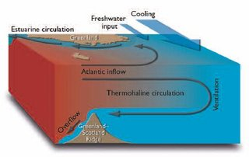
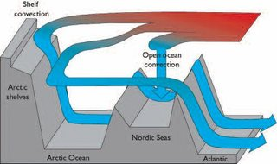
Loeng, H. et al, CAMEL Climate Change Edu., 9.2.3 of the Arctic Climate Impact Assessment
Notes:
Changes in modes and deep water ventilation, atmospheric carbon 14 used as proxy for THC changes.

Slide 13
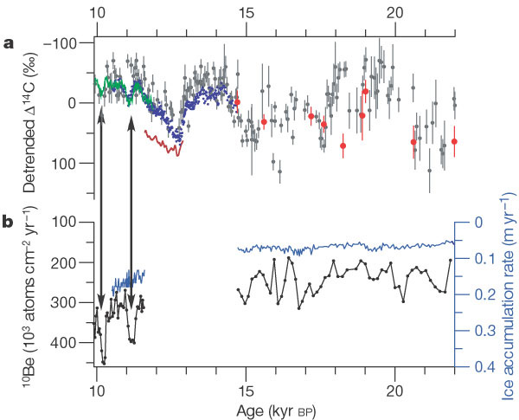
Agenda
What is atmospheric radiocarbon?
Why does Beryllium-10 matter?
What does Figure 1 communicate?
Notes:
Jesse

Slide 14
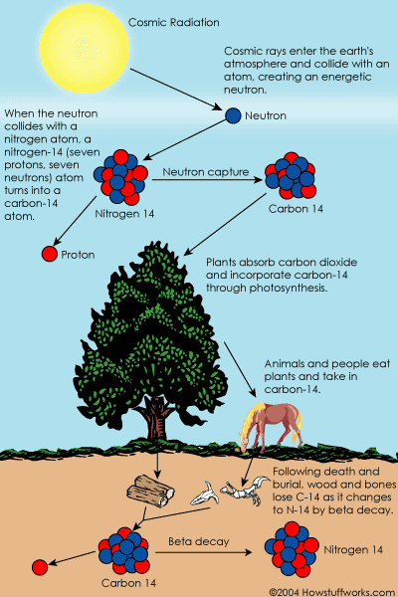
Atmospheric Radiocarbon
A function of the production rate of 14C in the upper atmosphere and the sizes of and exchange rates between the major carbon reservoirs.
Notes:
Jesse

Slide 15
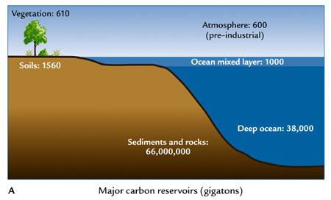
Major carbon reservoirs
Sediments, Ocean, Terrestrial biosphere
Ruddiman, 2001
Notes:
Jesse

Slide 16
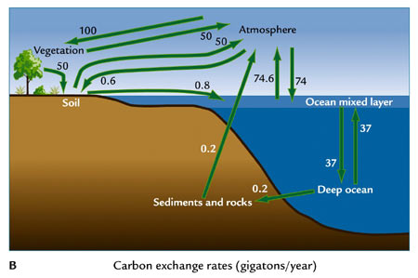
Carbon exchange
Atmospheric radiocarbon offers great promise for identifying past changes in the globally integrated thermohaline circulation.
Ruddiman, 2001
Notes:
Jesse

Slide 17
Beryllium-10
Can be used to estimate past changes in cosmic radiation because 10Be is rapidly (1-2yr) removed from the atmosphere to the ice surface by precipitation.
Beryllium increases/decreases are linked to cosmogenic radiation that can help explain fluctuations in 14C.
Notes:
Jesse

Slide 18
Figure 1
Stronger THC = greater negative values of 14C
Bolling-Allerod warm period: 14,700 to 12,700 BP
Younger Dryas: 12,800 to 11,500 BP
Notes:
Jesse

Slide 19
References
Brain, M., 2004, How Carbon-14 Dating Works, How Stuff Works, http://www.howstuffworks.com/environmental/earth/geology/carbon-14.htm (October 23, 2012)
Falkowski, P. et al, 2000, The Global Carbon Cycle: A Test of our Knowledge of Earth as a System, Science, Vol. 290 no. 5490, p. 291-296.
Ruddiman, W. F., 2001. Earth's Climate: past and future. W.H. Freeman & Sons, New York.
Notes:
Jesse

Slide 20
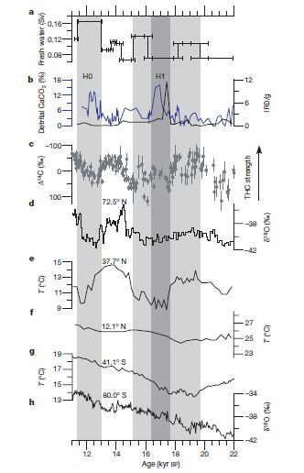
Freshwater influx
Clark, P.U. et al, Nature , 2002 Vol 415, Figure 2
Notes:
D-O events indicated shift from Modern to glacial nodes
Millennial scale changes
Preferred spacing of ~1500
Amplified normal cycles?
Atmos transmitted cycle beyond N.A.
H0 mode, large cooling in N.A., warming in S. H. (indicates decreased meridional heat transport from S.A.)
Does not hold true for older D-O, only younger dryas
Two mechanisms in THC climate variability: ocean (seesaw) & atmosphere

Slide 21
Empirical Orthogonal Functions
18 time series of climate change
68% variance – captures glacial/interglacial changes on a 10 kyr timescale
15% variance – captures spatial and temporal expression of 1 kyr changes between 16 and 12 kya
Negatives over Antarctica & South Atlantic, positives everywhere else = N.A. climate signal transmitted everywhere (except in seesaw locations)
Notes:
Seesaw intervals using EOFs also found for 26 – 50 kya
Modeling challenges with varying timescales (modes, EQ states), how to capture abruptness?

Slide 22
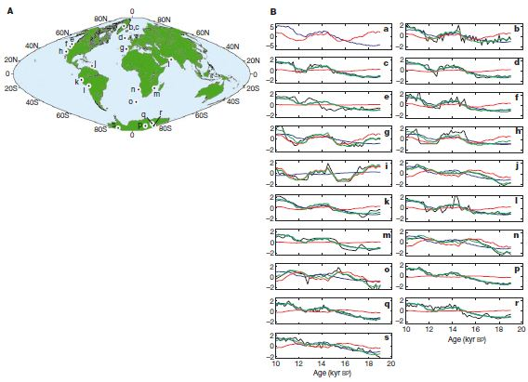
Figure 3
Clark, P.U. et al, Nature , 2002 Vol 415, Figure 3

Slide 23
Modeling
Abrupt change – 2 ways
  Fast forcing
  New equilibrium from threshold crossing
Evidence suggests that the THC has two preferred stable states; flip-flops from one to another
Models have found three modes of THC in paleoclimate
  Models also indicated these changes were from freshwater changes
Notes:
Seesaw intervals using EOFs also found for 26 – 50 kya
More data on freshwater needed (precip, run off, icebergs, discharge, sea ice)
Shut down of THC in models shows increased carbon 14 in atmosphere, but with half the amplitude
THC is sensitive to small changes in freshwater

Slide 24
Last thoughts…
Behavior of climate change can be modeled, but the cause and effect is not fully understood
Modeling provides ideas for mechanisms of change, possible future warming, and the earths’ system responses.
Coupled system models can be enhanced with geologic data
If heat transport is stopped by the THC being off, then could there be an offset in heat from global warming at the northern latitudes

